Slide 1


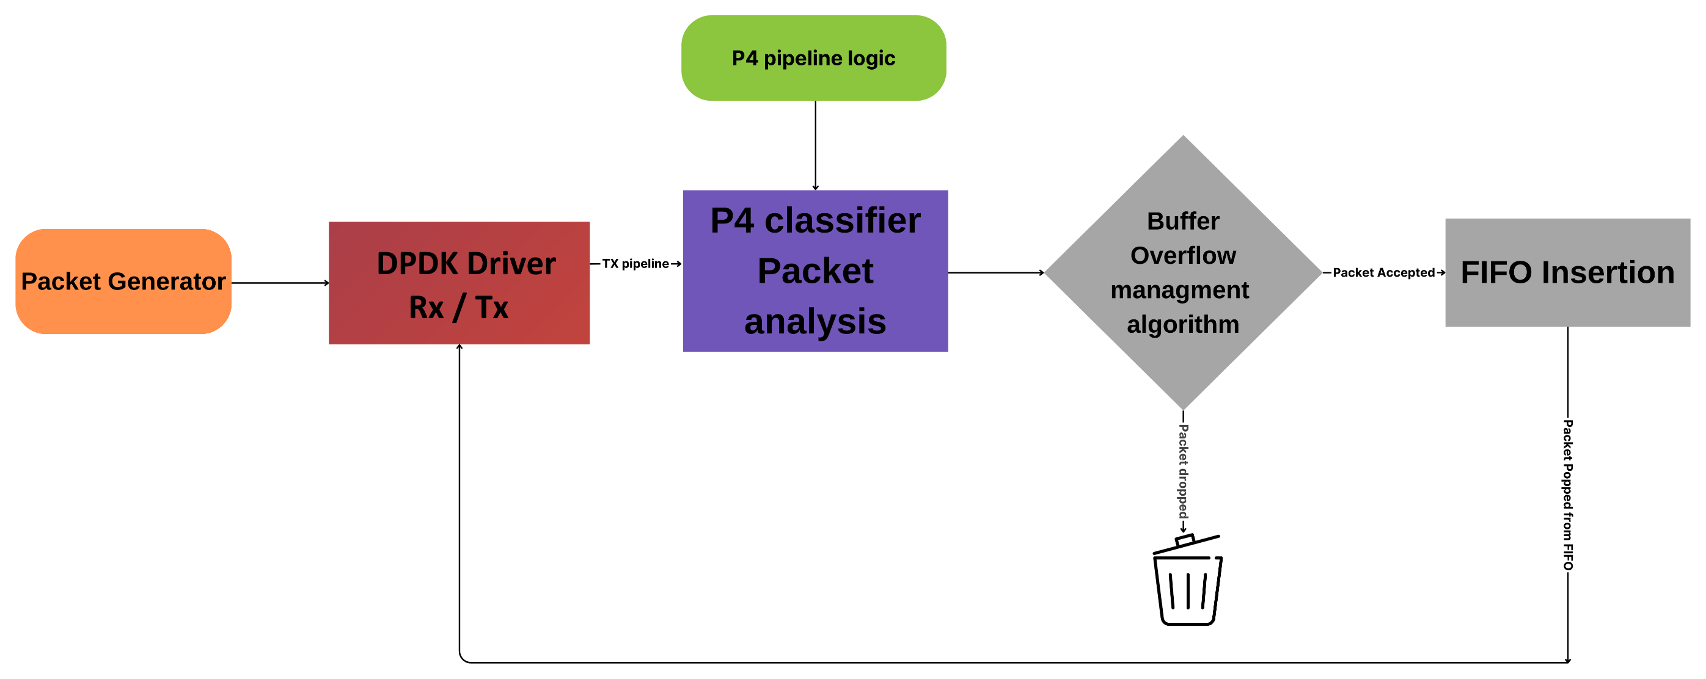
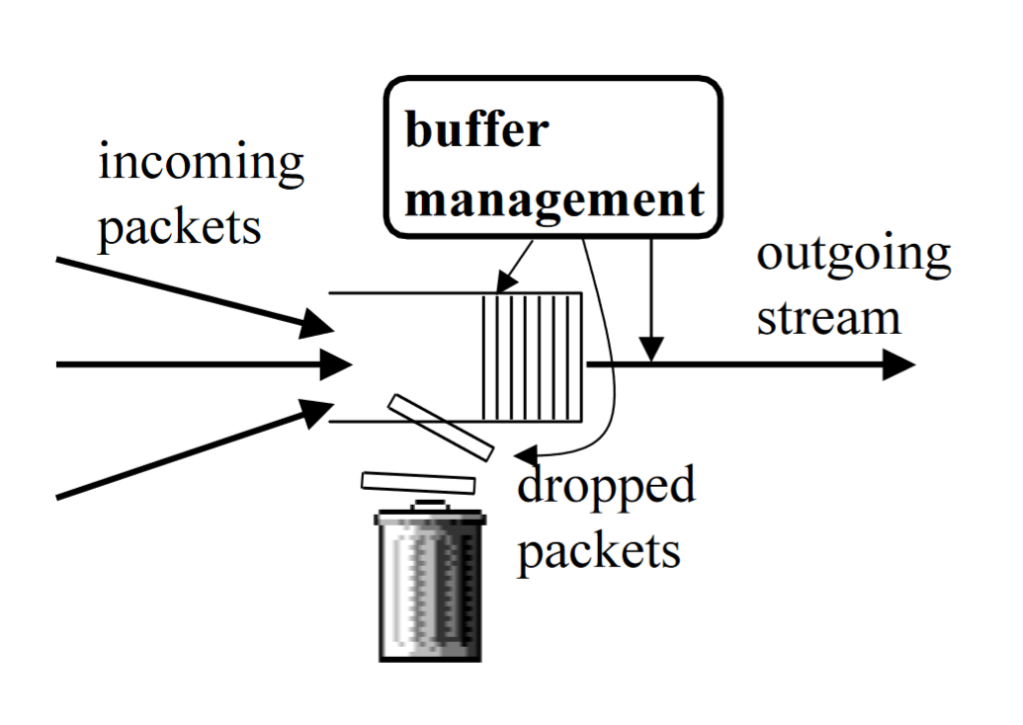
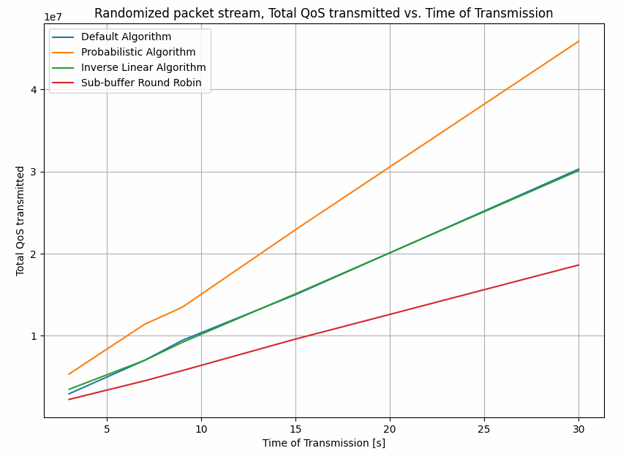
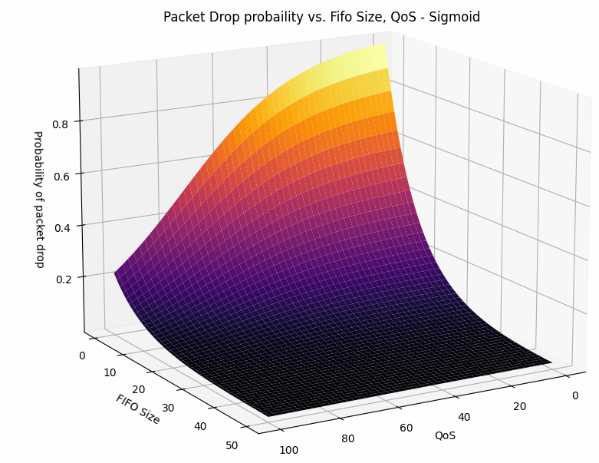
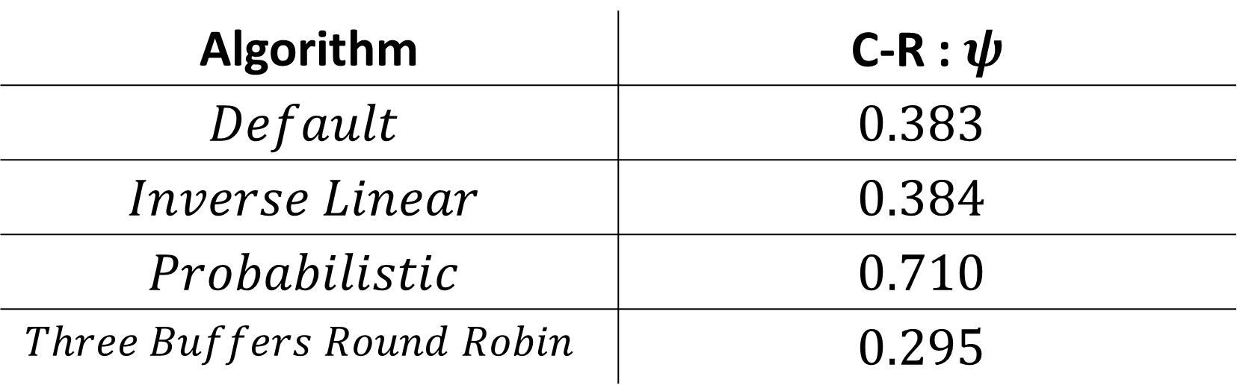
DPDK-P4 Configurable Switch with Buffer Overflow Management
Project Number: 22-1-2-2599
Names: Guy Davidi, Amit Davidi
Advisor: Stefan Chulski
Introduction This project involved the design and implementation of a software switch using DPDK (Data Plane Development Kit) that is configurable with P4 (Programming Protocol-Independent Packet Processors). Additionally, a classifier and buffer overflow management algorithm was implemented to ensure reliable network performance in a high-stress network state. Objectives Research the P4 Programming language capabilities, the DPDK libraries and their integration. Research real-time configurable software switches, SDNs and their practical implementation. Improvement of Quality of Service in a buffer-overflow (High-Stress) Scenario where packets are dropped. Development of a platform that enables engineers to deploy and evaluate their next-gen on-switch algorithms. | Methods Our Integrated solution is comprised of two main stages: A packet classifier that can be configured in real-time. The classifier is being loaded to the system in real-time using P4. The classifier assigns a Quality of Service (QoS) value to each packet. Buffer-overflow management algorithm, Implemented in the NIC’s DPDK driver (depends on the free buffer space and the packet’s QoS). Default algorithm – Every packet passes. Three Buffers Round Robin – The buffer is split into three sub-buffers for handling packets with different priorities, and each sub-buffer is served in a round-robin manner. Inverse Linear algorithm – Packets pass \ dropped deterministically (QoS threshold). Probabilistic Algorithm – Packets are passes \ dropped based on a probability model: $$Φ\left(Buffer Size, QoS\right)=\frac{1}{e^{α⋅\left(QoS−β\right)}}⋅e^{−\frac{Buffer Size}{γ}}$$ A packet generator was utilized to pass randomized packets through the software switch. The system’s evaluation was based on the Total 𝑄𝑜𝑆 passed and the Competitive ratio of the algorithm. | Results We collected data of the total QoS passed through the switch and performed a competitive analysis of the different algorithms. $$Competitive Ratio=ψ=\frac{QoS obtained}{Best Case QoS}$$ Conclusions From our results we obtained, we observe a clear improvement of the default packet forwarding procedure in a high-stress network state. Also, The switch can support different communication protocols, which can be configured in real-time. Bibliography [1] A. Kesselman, Z. Lotker, Y. Mansour, B. Schieber, M. Svirdenko and B. P Shamir. "Buffer Overflow Management in QoS Switches”
Algorithm | C-R : $ψ$
$$Default$$ | $$0.383$$
$$Inverse Linear$$ | $$0.384$$
$$Probabilistic$$ | $$0.710$$
$$Three Buffers Round Robin$$ | $$0.295$$

